Slide 1
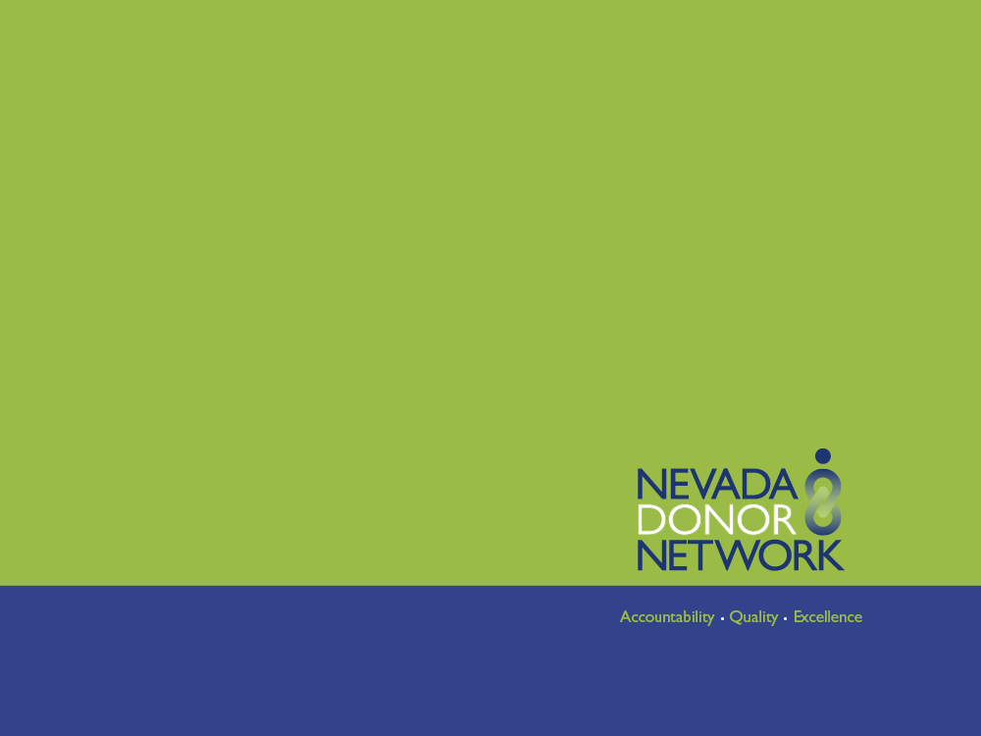



Saving Lives Through
Organ & Tissue Donation
Facebook.com/DonateLifeNevada
@DonateLife_NV
@DonateLifeNV

Slide 2
ABOUT NEVADA
DONOR NETWORK
Not-for-profit organ, tissue, and eye procurement organization
Recover organs from deceased donors only
Educate the public about donation and the importance of registration

Slide 3
WHY TRANSPLANT
IS NEEDED
The body’s organs or tissues can be:
Formed abnormally at birth
Damaged as a result of accidental injury or disease
THEY MAY NEED TO BE REPLACED TO SURVIVE
Notes:
Certain conditions, like kidney disease and heart conditions can be present at birth and lead to the need for an organ transplant. Other times, people need a transplant after being involved in an accident (car accidents are the most frequent) or developing a disease that harms their organs.

Slide 4

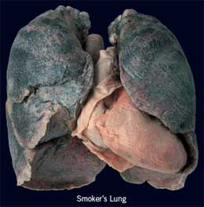
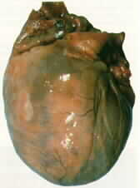
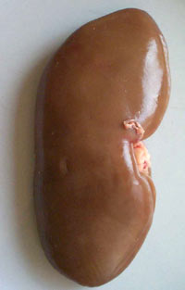
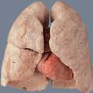
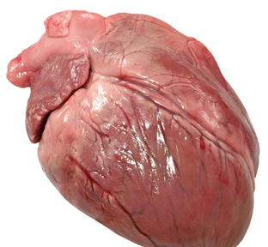
Diseased Kidney
vs.
Normal Kidney
Diseased Lung vs.
Healthy Lung
Diseased Heart vs.
Healthy Heart
Notes:
On the left is a polycystic kidney, all the black and white spots are cysts. In the center is a smoker’s lungs. On the right is an enlarged heart.

Slide 5

NATIONAL
WAITING LIST
Total | 123,207
Kidney | 101,033
Liver | 15,754
Heart | 4,009
Kidney/Pancreas | 2,055
Lung | 1,602
Pancreas | 1,189
Small Intestine | 264
Heart/Lung | 52
  570 Nevadans need an organ transplant
  (As of 7/1/14)
Based on data from Organ Procurement & Transplantation Network
http://optn.transplant.hrsa.gov/
Notes:
The majority of people (about 80%) on the waiting list are waiting for a kidney

Slide 6
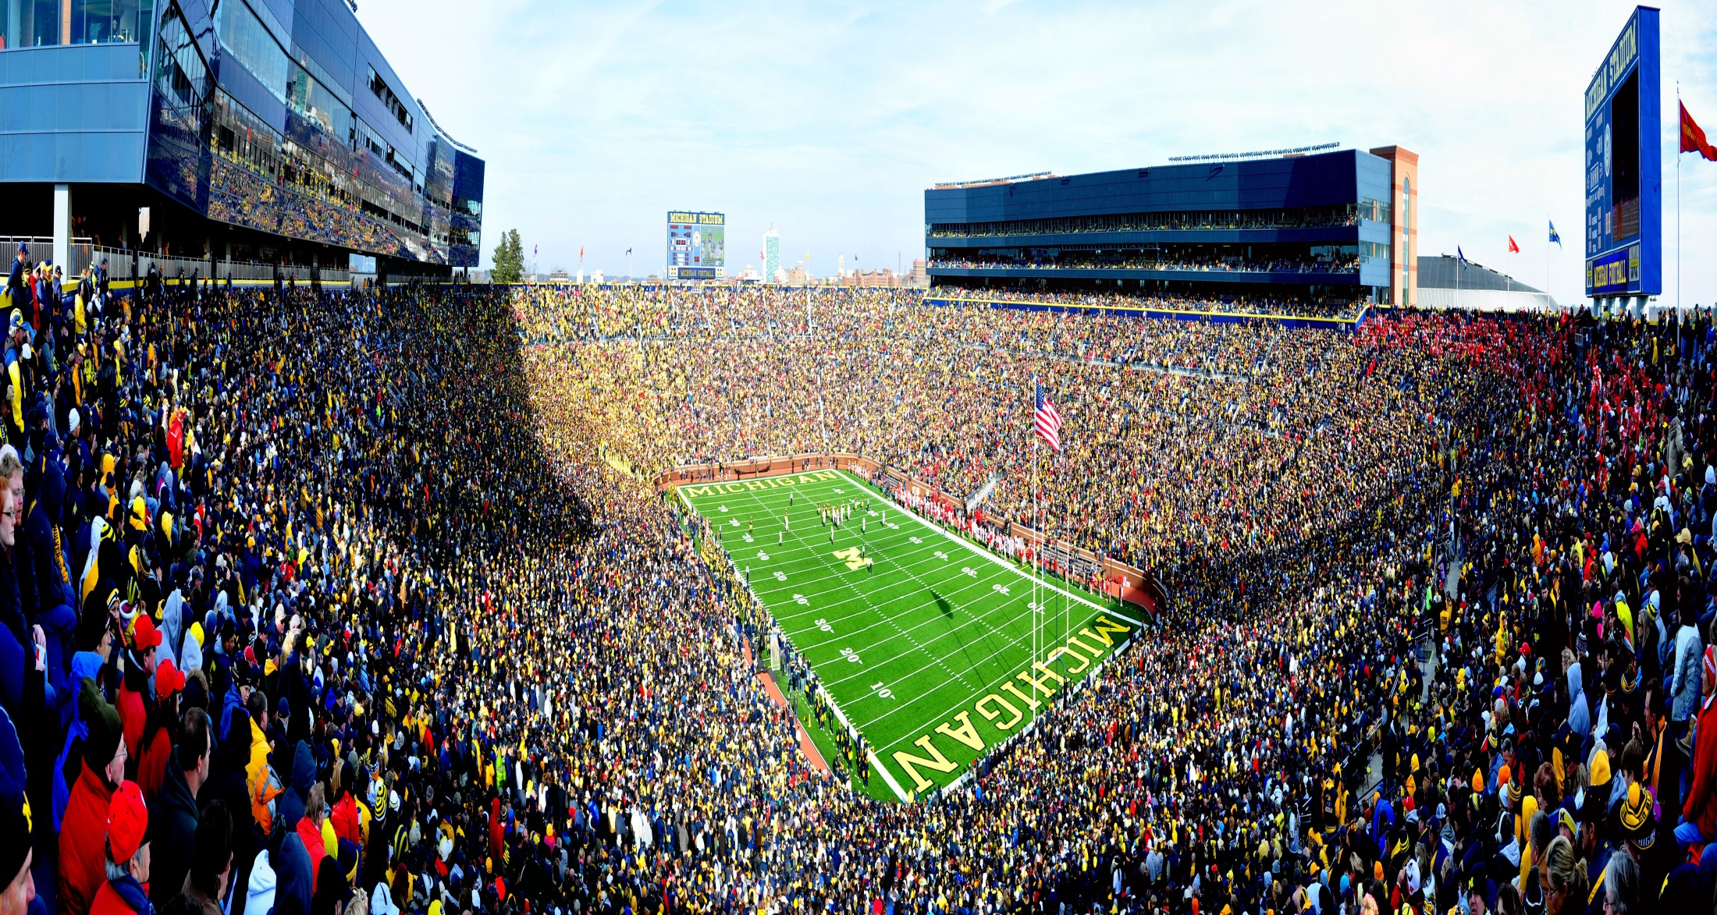
What does 123,000 look like?
Michigan Stadium holds close to 110,000
18 Americans die every day waiting
Notes:
Add another 13,000 people to this stadium, and that represents the number of people across the U.S. waiting for a life-saving transplant. There just aren’t enough organs to go around, which tragically means that 18 people die each day while waiting on the list.

Slide 7

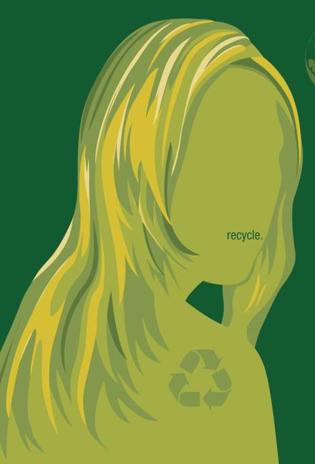

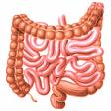
A DONOR’S IMPACT
Notes:
One person can make a big difference –one organ donor can save up to 8 people through organ donation

Slide 8
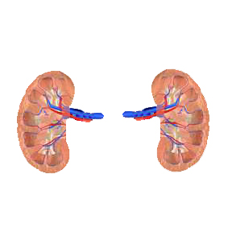
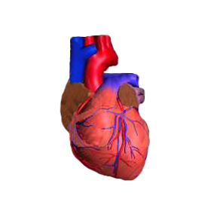
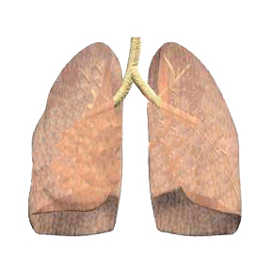
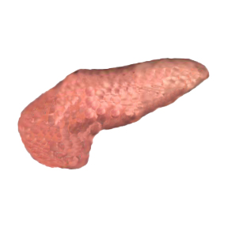
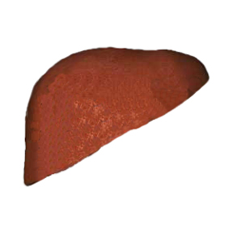
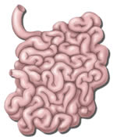
ORGANS THAT CAN
BE DONATED
Heart
4-6 hours
Kidneys
48-72 Hours
Lungs
4-6 hours
Pancreas
12-24 Hours
Liver
24 hours
Small Intestine
6 Hours
Notes:
There are 6 organs we can donate – so how can 1 person save 8 people? (ANSWER) The kidneys and lungs can be split. We are born with 2 kidneys but only need one to survive so only one is transplanted. Lungs aren’t always split but they can be – that depends on what the recipient needs. The times listed in blue are how long an organ can survive after being recovered from the donor’s body. Technology is helping change that to increase the time the organ can survive out of the body before it is transplanted. (If you have internet access, click on the heart image and a YouTube video shows how technology is helping to increase that time)

Slide 9
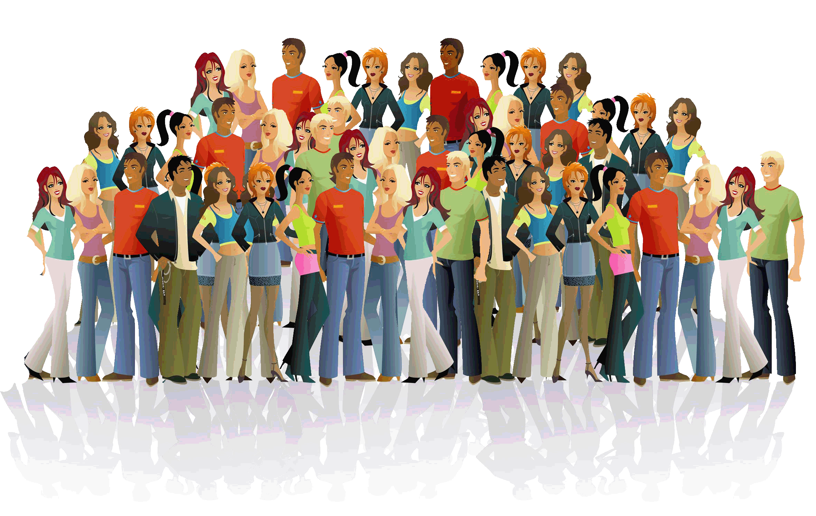
ONE TISSUE DONOR CAN HEAL MORE THAN 50 PEOPLE
Notes:
A tissue donor can help enhance the lives of up to 50 people – sometimes even hundreds of people can be helped by just one tissue donor.

Slide 10
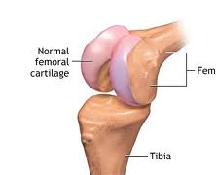
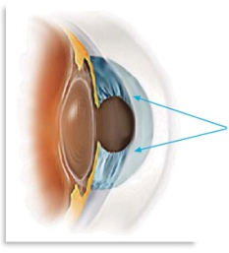
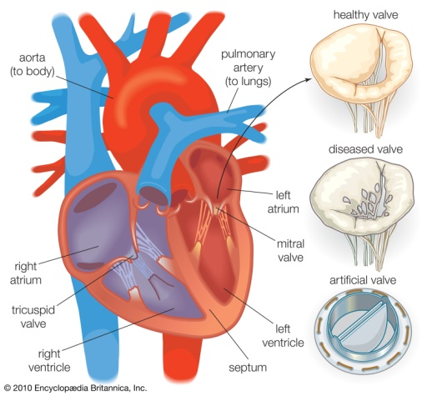
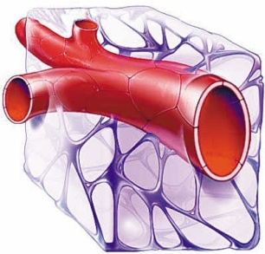
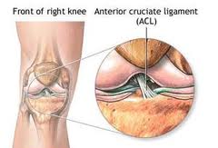
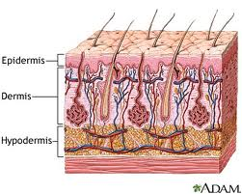
TISSUES THAT
CAN BE DONATED
Cornea
2 weeks
Bone & Cartilage
5 years
Blood Vessels
5 years
Heart Valves
5 years
Tendons & Ligaments
5 years
Skin
5 Years
Notes:
Corneas – can restore vision to someone suffering from corneal blindness
Bone – can be used in dental surgeries, spinal fusion surgeries
Skin – can be used to treat burn victims, in reconstructive surgeries such as a mastectomy
Tendons & Ligaments – often used to repair common sports injuries like torn ACL or MCL
Unlike organs which have be to transplanted immediately, tissues can be preserved, most up to 5 years. Tissue can be used multiple times over the course of those 5 year.

Slide 11
IF A TRANSPLANT IS NEEDED
Patient Placed on Waiting List
Time on Wait List:
Blood Type, Medical Urgency, Organ Size
Visit Transplant Center for Evaluation
Living donation from family or friend
Notes:
Transplant is a specialty just like other areas of medicine so your doctor would refer you to a transplant center for evaluation. We only have one transplant center in Nevada (UMC) and they only perform kidney transplants. That means anyone needing a different organ will have to go out of state for the transplant. BUT you can still donate everything here.
If the patient is a good candidate for transplant, they will be placed on the national waiting list. Getting on the waiting list can be hard. You have to be sick enough that you desperately need the organ to survive but must be healthy enough to survive the major surgery.
BLOOOD TYPE must be compatible between donor and recipient – MEDICAL URGENCY , the sicker a person is the higher they are on the waiting list BUT all other factors matter so a less sick person may get the first organ based on medical compatibility – ORGAN SIZE – donated organ should be similar in size to patient's current organ. Must fit in the space (example a 6’3” man’s heart won’t fit in the small chest cavity of a 5’3” woman AND a smaller person’s heart won’t be large and strong enough to pump blood through the body of a much larger person)
Patient may also have a friend or family member who can be a living donor – kidneys are most common for living donation

Slide 12
TYPES OF DONORS
Brain Death Donors
Cardiac Death Donors

Slide 13
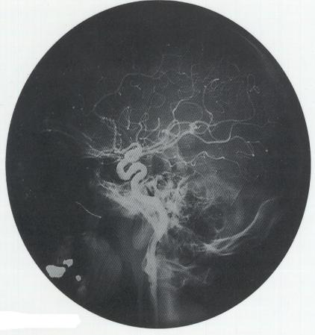
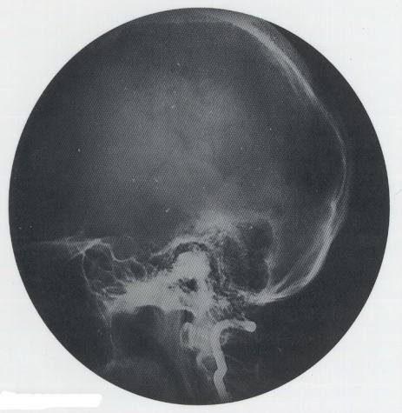
BRAIN DEATH
Irreversible cessation of all brain function including the brain stem
Normal Blood Flow
Brain Dead
Notes:
Most organ donors die from brain death. (Read definition) Doctors do a number of different tests to test for brain death. They start with simple tests like shining a light in a patient’s eye or checking their reflexes. One of the final tests is a scan of the brain (seen here) you can see all the wavy lines on the left – those show normal blood flow to the brain and normal brain function. On the right is a brain dead patient – you can see there is no activity.

Slide 14
WHAT CAN CAUSE
BRAIN DEATH?
Severe injury to the head that hurts the brain
Lack of oxygen to the brain (drowning, heart attack)
Overdosing on medicine or drugs
Brain death is not a coma
- Brain functioning at its lowest stage of alertness
- Patient will not respond to voices or sounds
Notes:
Several things can cause brain death (CAR CRASH one of the most common causes of a severe head injury)
Many people think brain death and a coma are the same – they are not. (QUESTION – what’s the difference) A person in a coma MAY recover, they have a chance of survival. A person who is brain dead will not recover – brain death is death.

Slide 15
WHEN LIFESAVING
EFFORTS ARE UNSUCCESSFUL
Hospital Notifies donation agency
Donation can only proceed AFTER death has been declared
Coordinator searches for documentation of donation wishes
REGISTERED: Work with family to honor donor’s wishes
NOT REGISTERED: Talk with family to about donation
Notes:
When doctors have done everything possible and someone’s life cannot be saved – that’s when the hospital will notify the donation agency of a potential donor. Donation will only proceed after death has been declared. First step is for a coordinator to find out if the person was a registered donor. They will look up the person’s name in an electronic database. If the person’s name is in the database that means they are a registered donor. When that happens we will work with a family to honor the donor’s wishes. If the person is not registered, Nevada Donor Network will talk with the patient’s family about donation. This is a decision we want everyone to make for themselves. Families grieving a tragic loss have enough stress and we don’t want them to be burdened with the decision about donation. We also encourage everyone to make their wishes known to their family – we don’t want a family to be shocked when they learn their loved one was a registered donor.

Slide 16
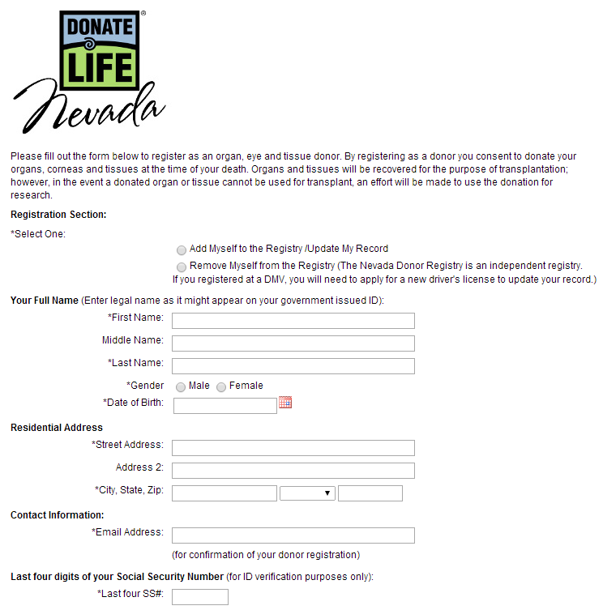
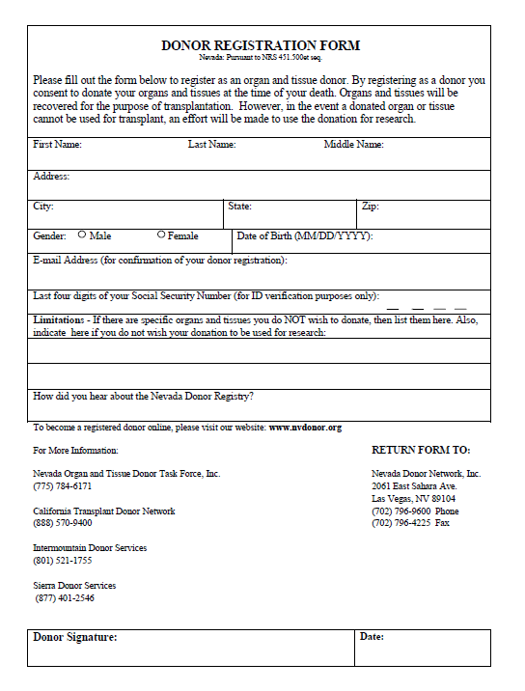
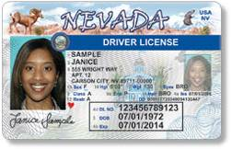
Registration in Nevada
is legally binding for anyone
over the
age of 18

Slide 17
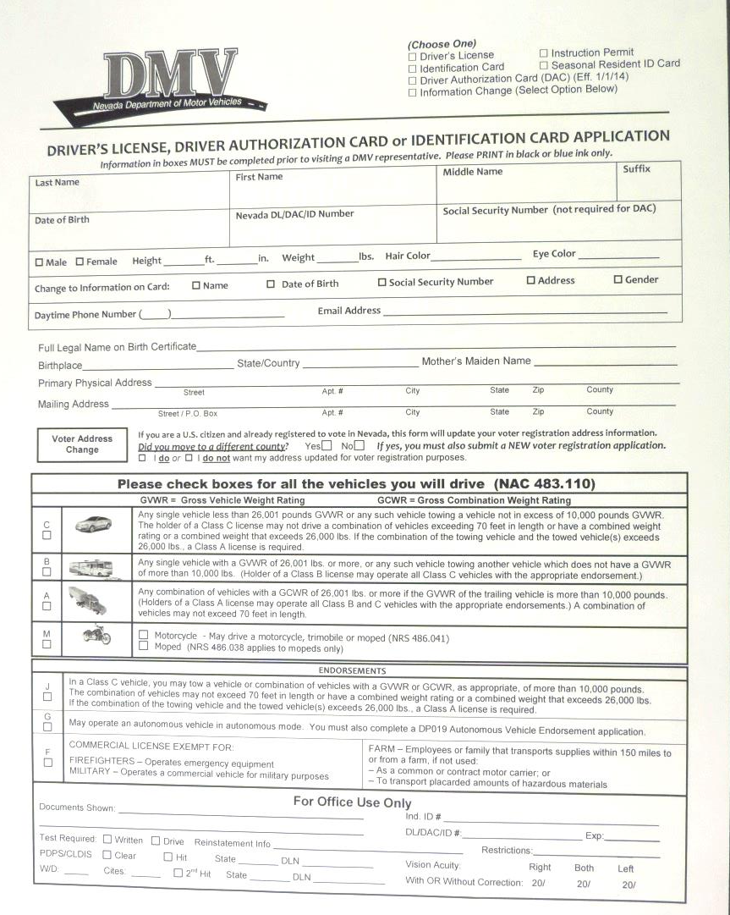
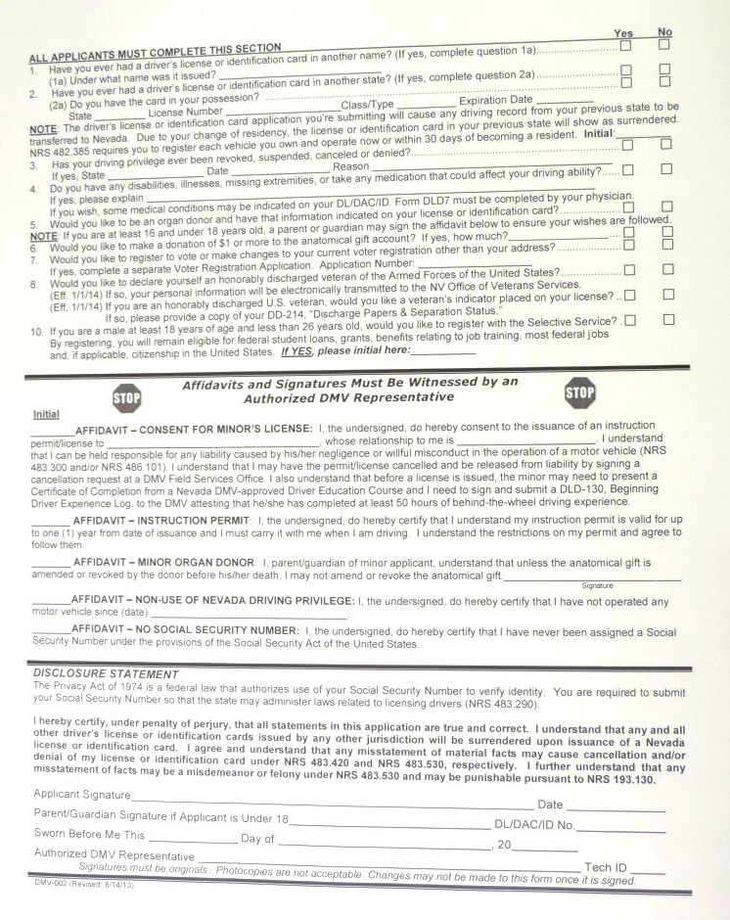
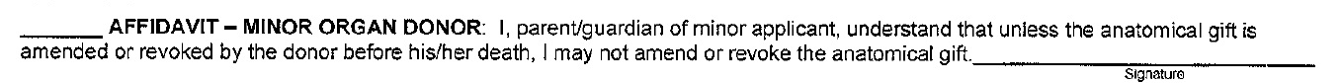
Under the age of 18?
Legally binding if:
Parent signs affidavit on DL application
Not legally binding if:
Parent doesn’t sign consent
Teen registers online
Teen registers using paper form
Notes:
When you register before you are 18 it is not legally binding – meaning your parents have the final decision. UNLESS your parent/guardian chooses to sign the affidavit on the lower portion of the application. If the affidavit is signed, your decision cannot be overturned if you were to die before turning 18. Once you turn 18, the decision automatically becomes legally binding.

Slide 18
So, why don’t more
people register
to donate?
Much of the time, it is unfortunately because of widespread myths.
Who has heard….

Slide 19
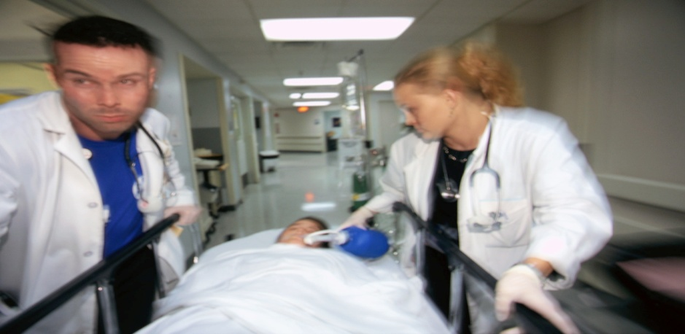
MYTH: “Doctors won’t save
my life if they know I’m a donor.”
FACT: A doctor’s focus is to save your life
The doctors & nurses involved with the transplant are not the same people who care for the patient during life.
Notes:
3 reasons this won’t happen:
1. The doctor’s focus is to save your life. That’s why they become doctors – because they want to save people.
2. The doctors and nurses treating a patient in a hospital have nothing to do with the transplant process. DO NOT believe what you see on TV – organ donation is most often portrayed inaccurately on TV.
3. When we get a call that a patient is a potential donor, we don’t refer to the driver’s license to see if someone has the heart. We look in the electronic database which is updated monthly by the DMV. The driver’s license may be old or expired so we use the most recent information, which is found in the database.

Slide 20
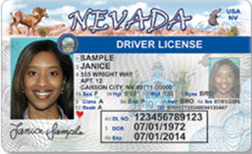
MYTH: “If I have a heart on my
license, I am giving consent to
become a deceased donor
as well as a living donor.”
FACT: The on your license only means you consent to donation after death

Slide 21
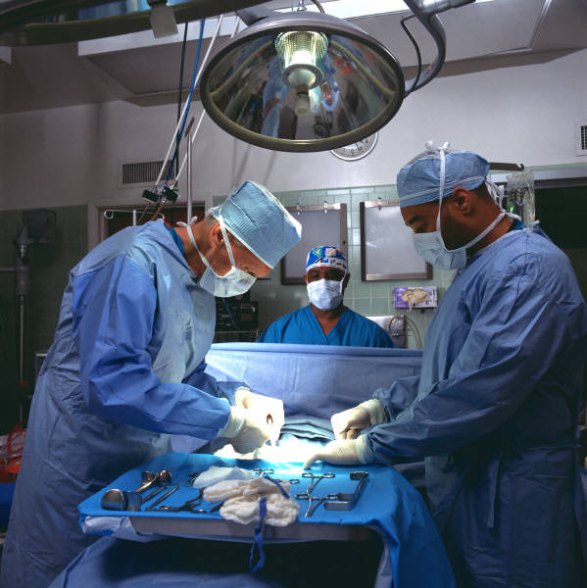
MYTH: “I don’t want my family to have to pay for extra expenses.”
FACT: There is no cost to the donor’s family for organ or tissue donation
Notes:
If a family is ever asked to pay for the donation costs it is an ERROR – and we make sure we tell our families to let us know if that error is made so we can help them takes care of it.

Slide 22

MYTH: “My religion doesn’t
support organ and tissue donation.”
FACT: All major religions around the world support or encourage donation

Slide 23

MYTH: “I won’t be able to have an open casket funeral.”
FACT: The body is treated with respect and dignity throughout the process, and will not look any different
Notes:
Organ recovery happens in an operating room like any other surgery and the patient is sewn back up just like a living patient. Tissue recovery is a little more complicated but steps can be taken to make sure there are no visible signs of tissue donation. Skin can be taken from places where it will be covered by clothing in an open casket. Bones removed can be replaced by rods to keep the body intact. If someone donates their corneas – the entire eye is not removed – only the cornea, which is just a small sliver like a contact lens.

Slide 24

What if I’m not 18?
Tell your family your decision so they
know your wishes (this is important even for those over age 18 who are registered!)
Notes:
If you are under 18 and you choose to say YES to donation – it is very important that you talk with your family and let them know that. It’s even important for adults to have that conversation so no one is shocked or caught off guard when they learn their loved one was a donor.

Slide 25
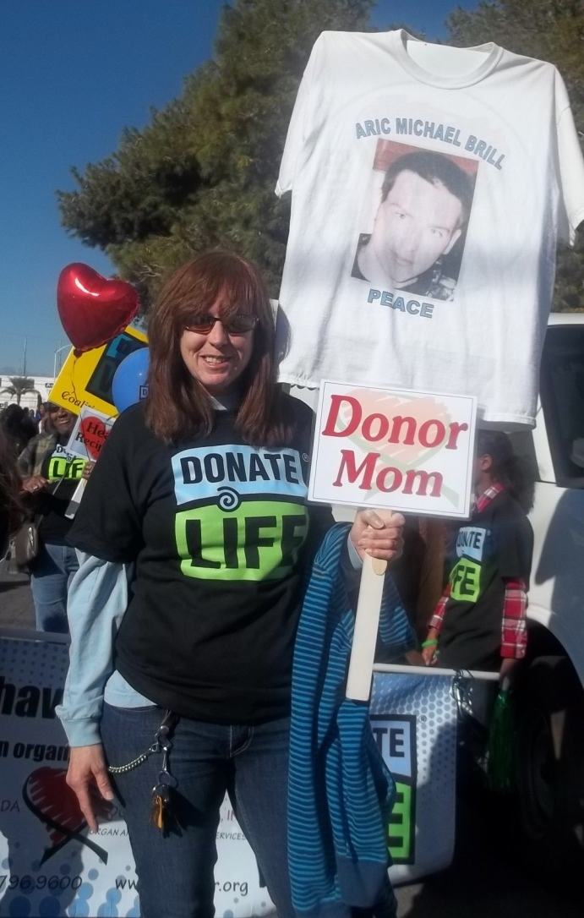
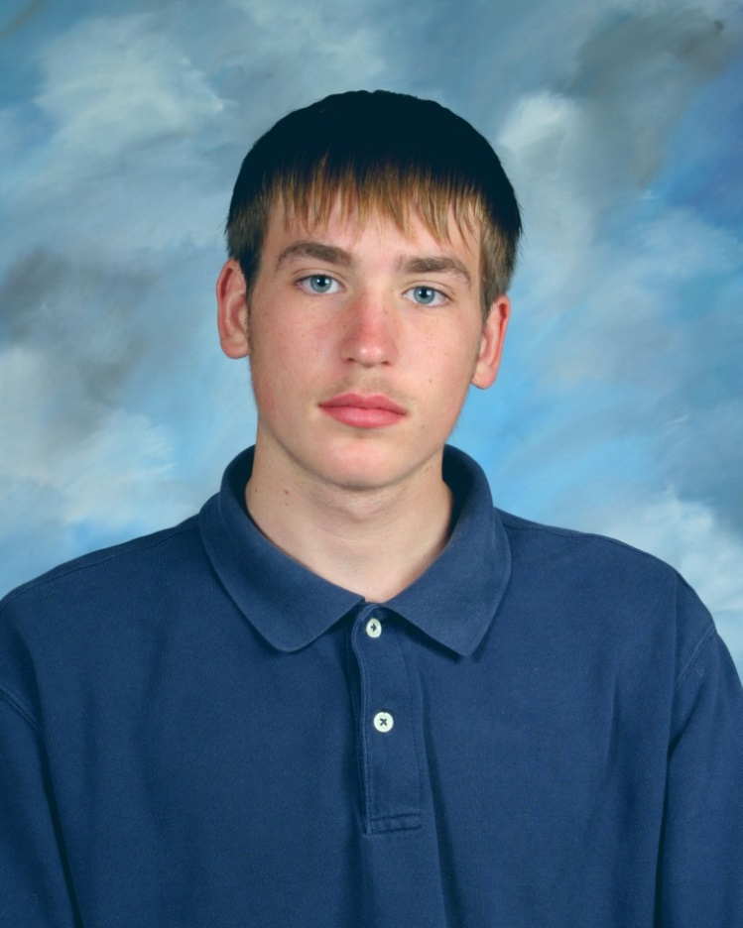
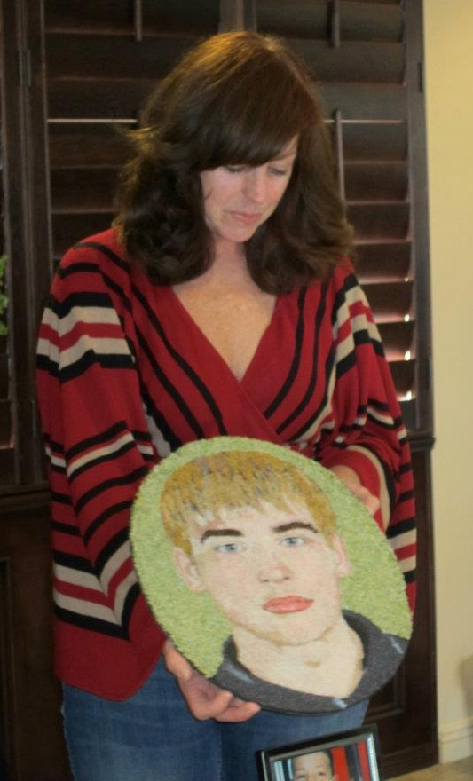
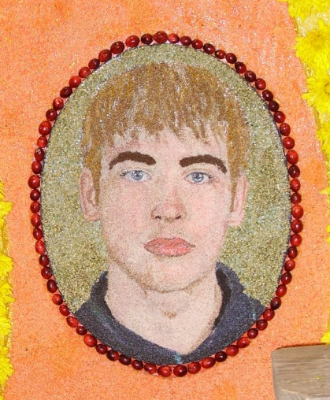
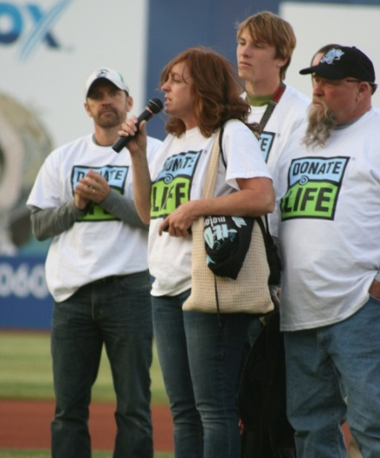
Aric Brill
Notes:
Aric Brill’s story highlights the importance of talking with your family. He told his mom when he went for her permit that he wanted to become a donor. When he was murdered at age 16, her first instinct was to say no. But she thought back to their conversation and realized that Aric wanted to help other people when he died so she said yes. His organs saved the lives of 6 people all because of that short conversation in the parking lot at the DMV.

Slide 26
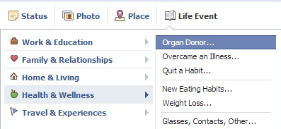
HOW TO REGISTER
AS A DONOR
DMV office
www.DonateLifeNevada.org
Facebook
Notes:
You can register when you apply for a permit or driver’s license at DMV. But you don’t have to wait. You can register online at any time by going to Donate Life Nevada dot org – just click on the red heart and the form will come up. You can also register on Facebook – choose Life Event, Select Health and Wellness, then choose Organ Donor. If you’re registered you can share that with your friends and possibly inspire someone else to do the same. If you’re not registered there will be a link for you to click on and register.

